Slide 1
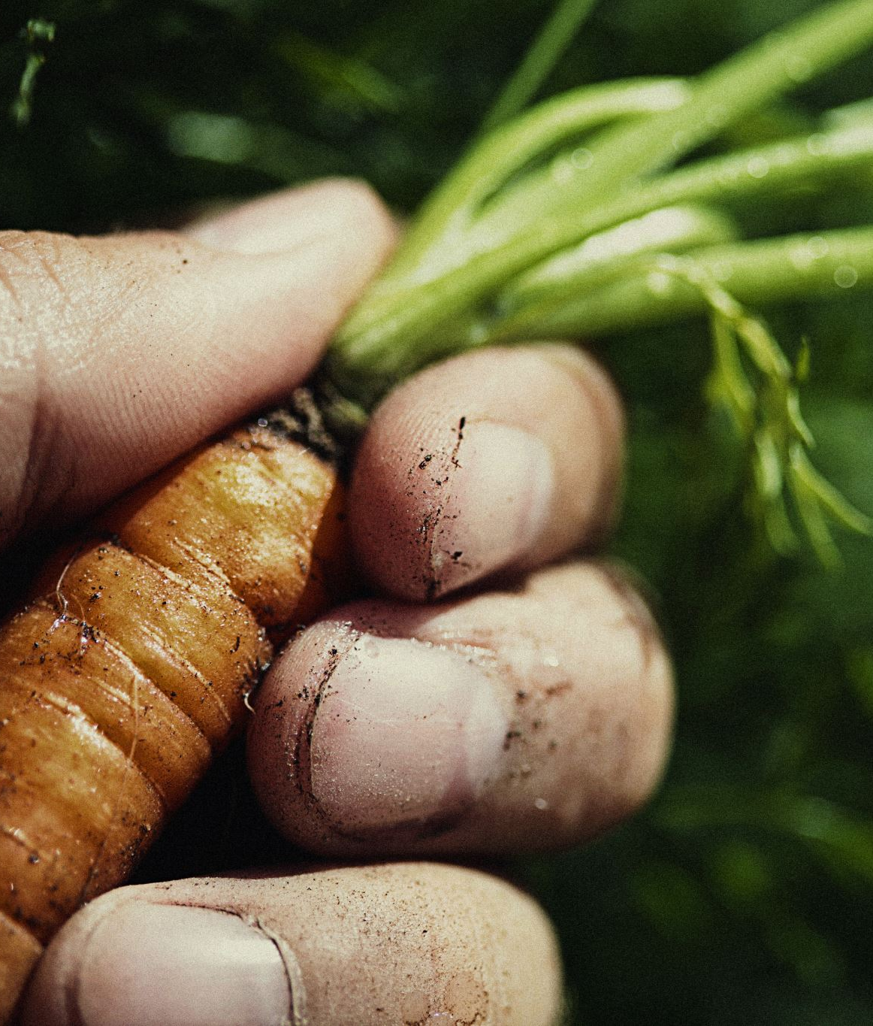
Individualized Culinary Experiences for Modified Diets
Design by Gala Angel
Culinary Director
Supported by Bre Gregory
RN LNHA

Slide 2
Objectives
Identify challenges with puree diets
Identify ways of improving the food experience for individuals served a puree diet
This Photo by Unknown Author is licensed under CC BY

Slide 3
First a few housekeeping notes:
You always need to ensure that the diet provided aligns with the resident’s preference.
You want to have a system in place to monitor both preference and necessity.
Is this diet still necessary? When are they re-evaluated by a Doctor, Speech Therapist or a repeat Swallow Study- what is the system there?
Is this still the diet they want? When are their diet preferences reviewed?
In our community we base everything off the care plan schedule. So diets and therapy needs are re-evaluated at least every quarter. If we believe someone may change before then, we utilize our PCC system in the form of a ‘Nursing Order’ to remind us to reevaluate.

Slide 4
Imagine you are prescribed a puree diet
How would that make you feel?
This Photo by Unknown Author is licensed under CC BY

Slide 5
For most of us…..

Slide 6
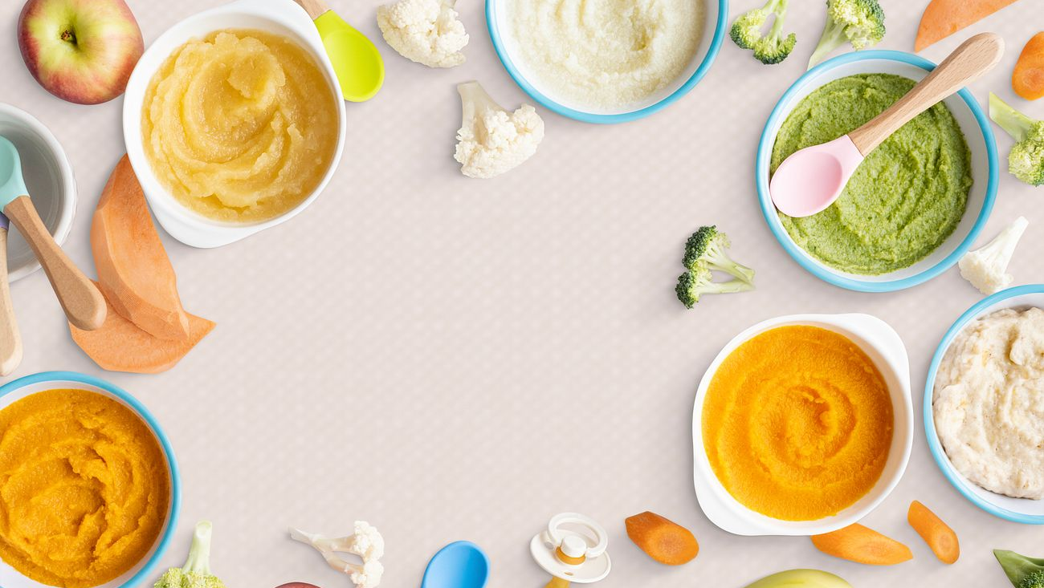
But WHY??

Slide 7
Changing the texture actually does change the taste
In a study published in Frontiers in Nutrition, scientists noted that even really well molded foods, still tasted different. Even when the participants knew what they were eating, tried the whole food and then ate the pureed food, the mold did not help the flavor.
Its not just about how it looks!

Slide 8
If food molds don’t help the flavor, why use them?
Think Keto Diet: Kale Chips, Cauliflower ‘potatoes’, the diet industry has this figured out!
Dignity. Food molds can help a person feel like they are eating peas with everyone else, even if they aren’t.

Slide 9
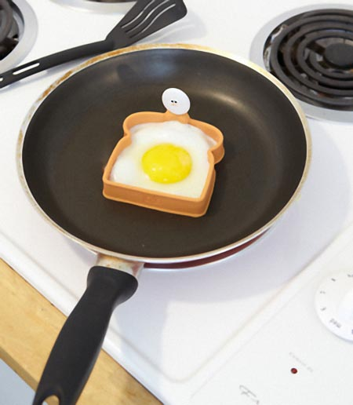
Food Molds
They are more common than you think! You can
get a variety
of different
food molds to
help foods
look better
This Photo by Unknown Author is licensed under CC BY-SA-NC

Slide 10
Another study in Foods Magazine
Rescuing Flavor Identity and Dynamic Perception in Pureed Dishes
Researchers found that when participants ate a food like pizza and then they blended it the participants still could not identify it because when you blend something you break up those proteins and change the flavor profile completely. So it stands to reason that just like when you whip cream and it turns into whipped cream, when you blend pizza it changes the flavor.
Carrillo E, Laguna L, Arancibia C, Tárrega A. Rescuing Flavor Identity and Dynamic Perception in Puréed Dishes; A Restructuring Solution for the Purée Diet. Foods. 2021; 10(4):905.

Slide 11
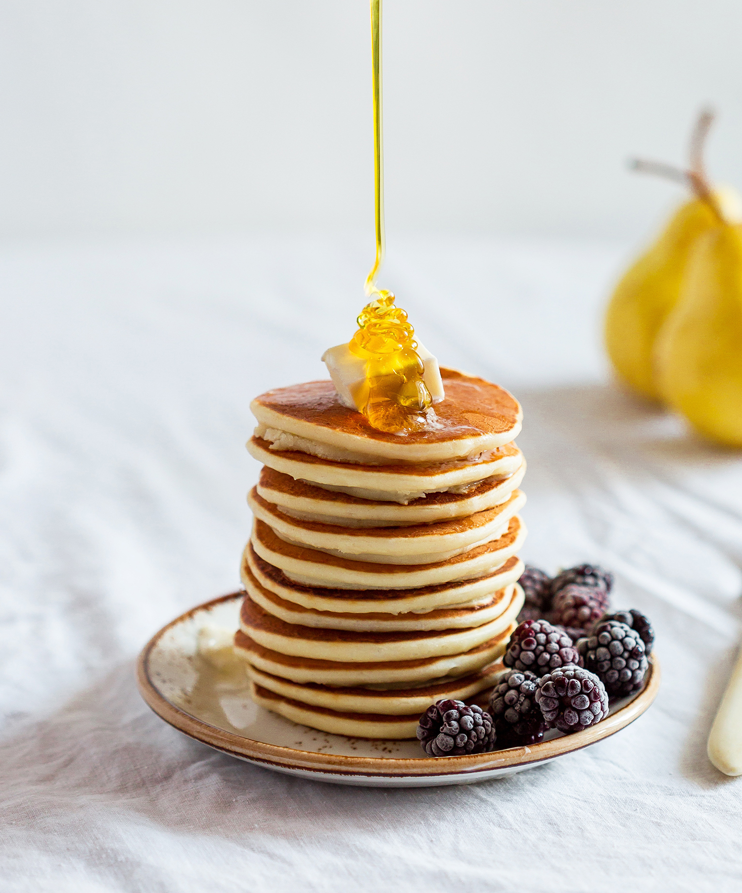
What can we do to improve the taste?
Keep it SIMPLE! Go for ONE or TWO flavors. If you are serving pancakes, go for syrup or syrup and butter.
If you are serving Chicken go for Chicken stock or poultry seasoning.
If we are going for hamburgers, add liquid smoke.

Slide 12
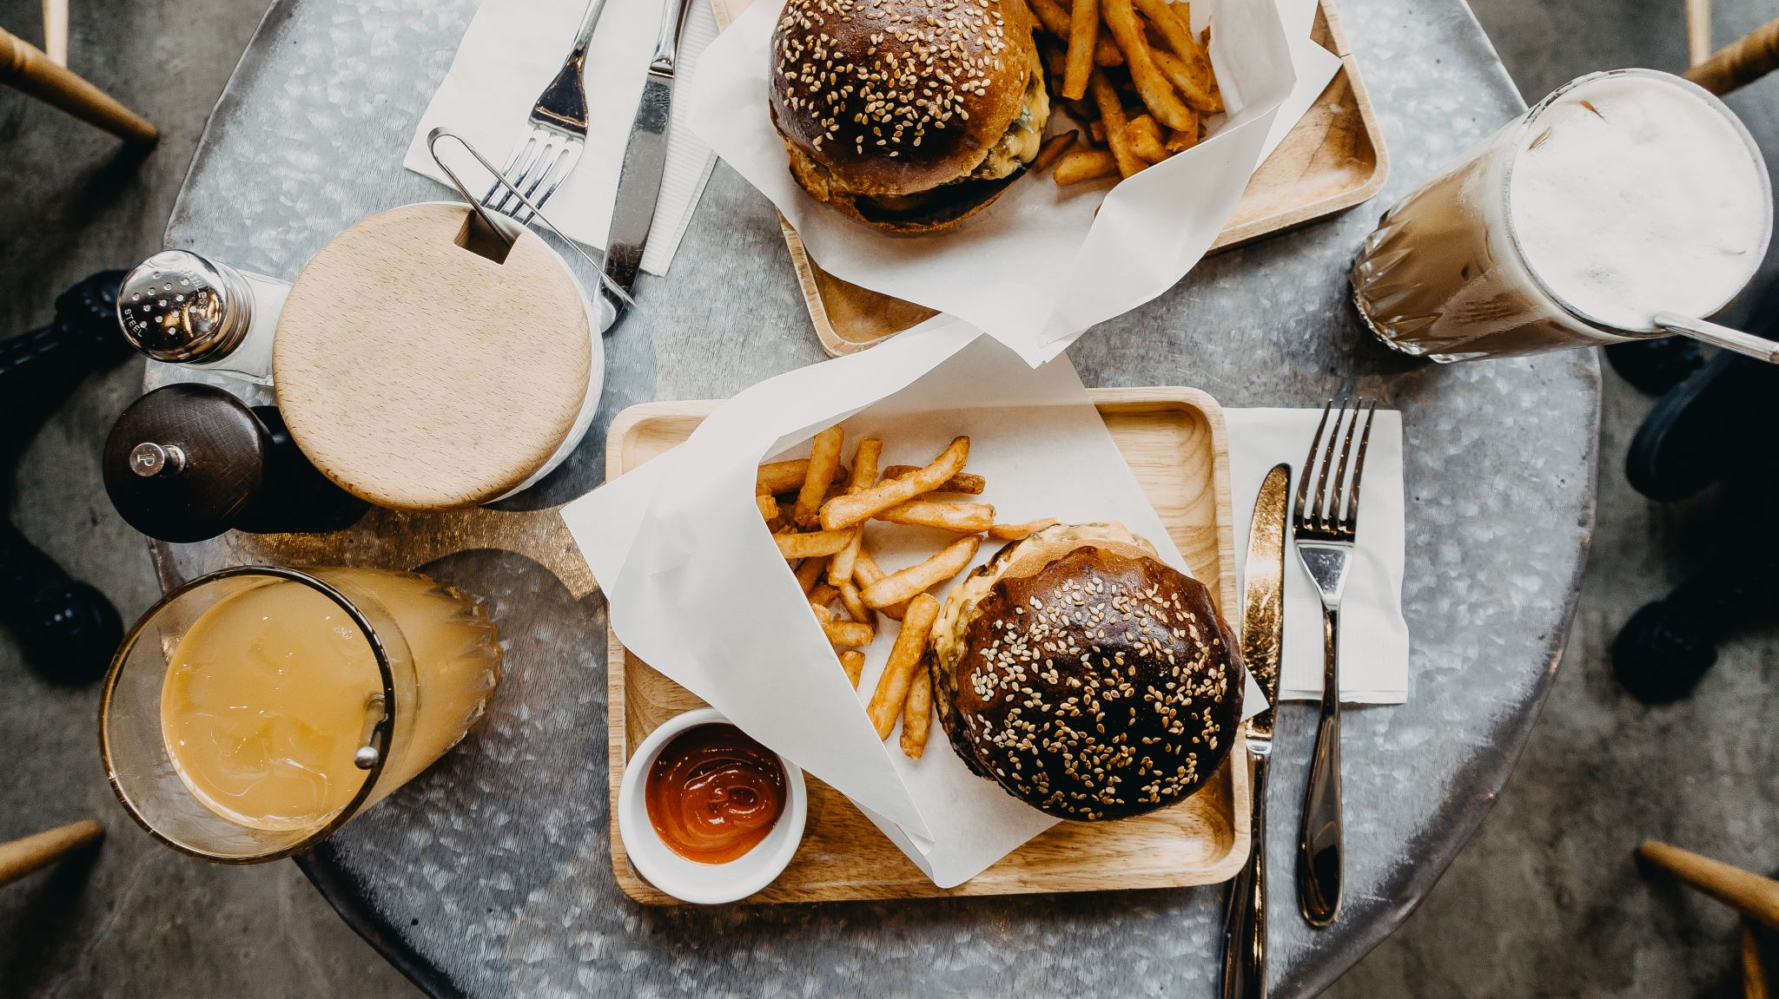
Taste Tests
We have 3 different entrees to share.

Slide 13
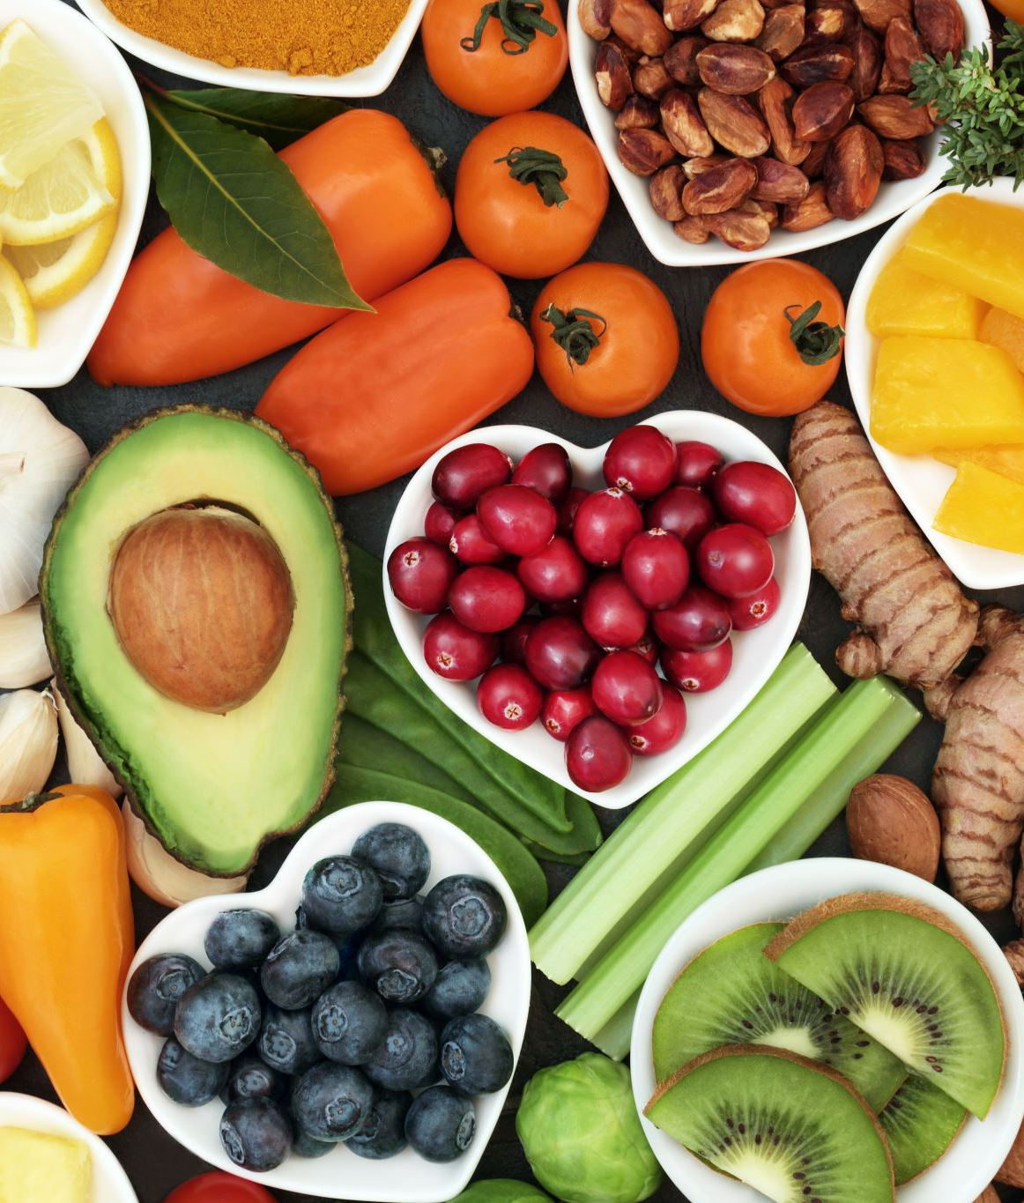
The Test Questions
Before preparing any puree foods, ask yourself these questions:
When I think about this food, what are the 1 or 2 primary flavors?
How can I create those flavors and add it safely into the food- this may take coordination with a registered dietitian. Sometimes it does not, like pancake syrup.
What condiments can I add to this?
Is this a food that I can make look like the real thing?
Note: You will find that most of the problem solving is in the process, not the food itself.

Slide 14
Lets test our theories!
We are going to trial 3 different foods:
Carrots
Fried Chicken
Waffle

Slide 15
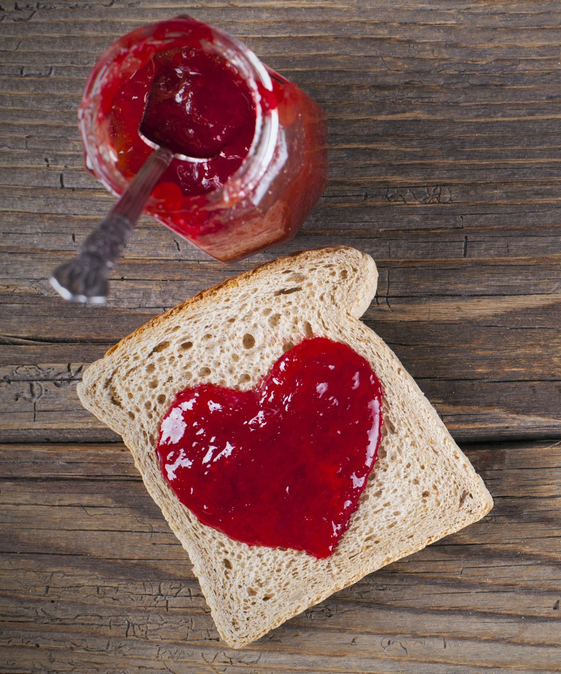
1. Toast
We are going to think through our questions:
1. When you think about toast, what do you think about? What 1 or two flavors come to mind.
2. How can we add in those flavors?
3. What condiments can I add?
4. Is this a food I can made look like the real thing?

Slide 16
References
Juan Yan, L. C., Quan Quan, P., Yiting, G. E., & Kwee Mien, S. I. (2023). Impact of a moulded pureed diet on taste, appearance, recognisability, and overall liking among patients in an acute hospital. Frontiers in Nutrition, 10(2296-861X), 1-3. https://doi.org/10.3389/fnut.2023.1248779
Carrillo E, Laguna L, Arancibia C, Tárrega A. Rescuing Flavor Identity and Dynamic Perception in Puréed Dishes; A Restructuring Solution for the Purée Diet. Foods. 2021; 10(4):905. https://doi.org/10.3390/foods10040905

